Slide 1
Washington Metropolitan Area Transit Authority
IFB NO: FQ17021/ER
ELECTRICAL AND DATA CABLING, PHASE 2
PRE-BID CONFERENCE & SITE VISIT PRESENTATION
February 14, 2017
10:00 AM
955 L’Enfant Plaza SW Suite 5300
Washington, DC 20024

Slide 2
Opening Remarks
Please silence all cell phones and pagers
No recording devices allowed
This presentation and attendee list will be provided on the wmata.com website
Safety Contact

Slide 3
Meeting Purpose
To promote a common understanding of the Electrical and Data Cabling, Phase 2 project
  Solicitation Instructions
  Project Requirements
To support an interactive discussion of solicitation content and requirements
To provide a networking opportunity to interested parties
Note: All questions must be submitted in writing via email to the Contract Administrator. Email your questions to Errol Roper at eroper@wmata.com by Wednesday, February 22, 2017, NLT 4:00 PM

Slide 4
Disclaimer
Disclaimer Regarding Changes to the Solicitation
The Pre-Bid Conference is for information purposes only. It may answer some Offeror questions. Statements or representations made during the conference are not legally binding. Changes resulting from this conference or the site visits are official only if issued through an Amendment to the IFB

Slide 5
IFB Solicitation Review Agenda
  Introductions
  Bidding Information
  Scope Statement
  Solicitation Content
  Contractor Qualifications
  Disadvantaged Business Enterprises
  Insurance Requirements
  Period of Performance and Project Milestones
  Working Hours
  Liquidated Damages
  Bid Sheets and Quantity Table
  Project Requirements
  Key Dates

Slide 6
Introductions
Errol Roper – Contract Administrator, PRMT
Terri Anomnachi – Project Manager, Treasury Technology
Jim Bongiorno – Project Sponsor, Treasury Technology
Jyotindra Shaw – Project Manager, RICM
Vadim Khizgilov – Construction Engineer, RICM
Elena Almonte – Office Engineer, RICM
Tinuade Akinshola – DBE Compliance Specialist, PRMT
Paulando Richards - Quality Assurance, QAA
Joy Forrest and Jim Hamilton- RISK
John Cribben and Angel Gonzales – Safety
Phil Obi – Program Manager, CPMO

Slide 7

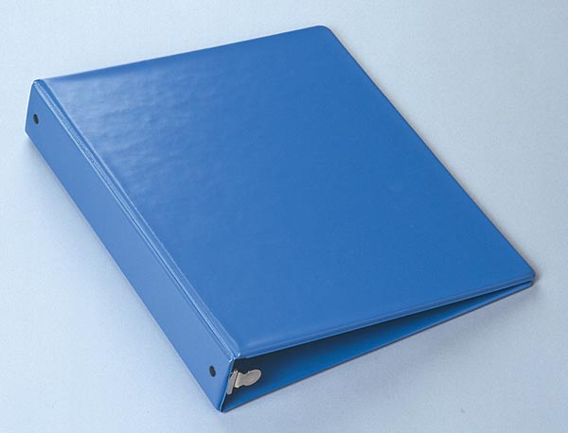
Bidding Material
Bid Form
Bid Price Schedule
Bid Guarantee
Bid Data Form with Supporting Data
Representations and Certifications
List of DBE Certified Firms
DBE Data
One (1) hard copy AND one (1) electronic copy submitted on USB

Slide 8

Bidding Material (cont’d)
The outside of the envelope shall show:
  THE AMENDMENTS RECEIVED (lower-left-hand corner). Failure to acknowledge all amendments may cause the Bid to be considered not responsive
  HOUR and DATE specified in the IFB for receipt, the IFB number, and the full legal name and address of the Bidder on the face of the envelope

Slide 9
Bidding Material (cont’d)
Bids are due March 15, 2017 no later than 2:00 PM delivered to WMATA JGB Meeting Room, First Floor
BASIS FOR AWARD: The Authority will award a contract to the lowest responsive and responsible bidder whose bid conforms to this IFB

Slide 10
Post-Bid/Pre-Award Submittals
Evidence of company and subcontractor qualifications and experience of key staff (resumes, licenses, and certifications)
Initial Primavera Cost-Loaded Project Schedule
Company Safety Plan
Company Quality Management Plan
Supplemental Installation Work Plan (Narrative/Work Approach)
Proof of Insurance

Slide 11
Award
AWARD
Apparent low bidder submits pre-award information within 5 days after bid opening
The goal is to award the contract within 21 calendar days after receiving pre-award information

Slide 12
Scope Statement
Installation of new under-floor duct and conduit raceways, electrical cabling circuits, and data cables at 83 Metrorail station mezzanines on the Red, Orange/Blue, and Green/Yellow lines in Virginia, Maryland, and Washington, DC
Contractor is responsible for all items and services as specified in the Invitation For Bid (IFB) that are required for the construction and satisfactory completion of the project
Contractor is responsible for implementing a Quality Management system to ensure that all work conforms to the specified requirements

Slide 13
Solicitation Content
Volume 1 – Specifications: Bidding and Contractual Requirements (Div. 0 & 1)
Volume 2 – Technical Specifications (Div. 2-16)
Volume 3 – Drawings
  Electrical Drawings (Parts 1a, 1b)
  AFC Mezzanine Plans (Parts 2a, 2b, 2c)
  Standard Kiosk Drawings (Parts 3a, 3b)
  New AFC Equipment Layout (Parts 4a, 4b, 4c)
Volume 4 – Reports
  Mezzanine Inspection Reports (Parts 1a, 1b)
  Pre-Inspection Reports (Parts 2a, 2b)
Volume 5 – WMATA Safety and Security Plans and Documents
  Construction Safety & Environmental Manual
  Metrorail Safety Rules & Procedures Handbook
  SOP
  Glossary
  Track Maps
  Safety & Security Certification Program Plan

Slide 14
Solicitation Content
Volume 1
Division 0
  Invitation
  Instructions
  Information available to Bidders
  Bid forms and DBE requirements
  Contracting, construction, and legal form
  Insurance and Bonding
  Invoice and payment requirements
  Contract reporting requirements
  All general and supplementary conditions

Slide 15
Solicitation Content
Volume 1
Division 1
  Technical requirements
    Key staff requirements
    Safety and environmental requirements
    Construction and mezzanine-specific work details
  Project-specific safety requirements
  Administrative requirements
    Project management requirements
    Meeting requirements
  Contract progress reporting
    Submittals and reports
    Project Schedules
  Quality requirements

Slide 16
Solicitation Content
Volumes 2-5
Volume 2
  Technical Specifications Division 2 - 16
Volume 3
  Drawings
    Electrical
    Mezzanine Plans
    Small & Large Kiosk Plans
Volume 4
  Pre-inspection reports
  Mezzanine inspection reports
Volume 5
  Safety and Security Plans

Slide 17
Contractor Qualifications
Experience
  Completed at least 3 contracts of similar scope, difficulty, and complexity as Prime Contractor
  Must provide resumes for key staff and key subcontractor personnel
    Project Manager
    Construction Manager
    Quality Manager
    Safety Superintendent
    First Aid Attendant
    Master Electrician
  Copies of all necessary certifications, licenses, etc.
Critical skilled laborers include Tile Setters, Cement Masons, and Electricians
Contractor shall perform, with its own organization, work equivalent to at least 50% of the construction work value

Slide 18
Other Requirements
Pre-Employment Criminal Background Check
  The Contractor and all Subcontractors shall comply with the Criminal Background check and Metro Identification Card requirements specified in the IFB.
WMATA will provide all floor tiles

Slide 19

Disadvantaged Business Enterprises
Submit complete schedule of Disadvantaged Business Enterprise (DBE) participation and Letters of Intent. All DBEs must have current WMATA DBE certifications
It is the policy of WMATA, the Federal Transit Administration (FTA), and the U.S. Department of Transportation (USDOT) that DBE’s shall have an equal opportunity to receive and participate in performing federally-assisted contracts, including contractors and subcontractors at any tier

Slide 20
DBE Requirements
DBE participation goal: 25.75% of the contract price
Certified DBE
  At least 51% ownership by socially & economically disadvantaged individuals
  Management and daily business operations controlled by the disadvantaged owners
  Possess the appropriate eligibility certifications
Reporting Requirements
  Contractor has a continuing obligation to maintain a schedule for DBE participation
  Contractor must certify payment to DBE within 10 days after receipt of payment from WMATA, and DBE must certify receipt of payment

Slide 21
DBE Summary of Submittals
With the Bid/Proposal
  Completed schedule of “DBE Participation” with current certification letters attached for each listed DBE
  Executed “Letters of Intent to Perform as a Subcontractor/Joint Venture”
  Justification for grant of relief (waiver of DBE goal), if applicable. Include completed “DBE Unavailability Certifications” as appropriate

Slide 22
DBE Summary of Submittals
Bid and Proposal Requirements (Apparent Successful Bidder/Proposer)
  All DBEs must submit a copy of their current WMATA or DC DOT certification letters or a certification letter issued by the MWUCP
  DBE Manufacturer’s Affidavit, if applicable, must be submitted in order to receive 100 percent of the allowable credit for expenditures to DBE manufacturers/suppliers
  Schedule B Information for Determining Joint Venture Eligibility, if applicable
  Copy of Joint Venture Agreement, if applicable
  Certification letter of the DBE regular dealer/supplier, if applicable

Slide 23
DBE Summary of Submittals
After Contract Award
  “Prompt Payment Report-Prime Contractor’s Report” – submitted monthly
  “Prompt Payment Report-Prime Subcontractor’s Report” – submitted monthly
  Contractor’s Canceled Check – submitted monthly
  Request to substitute/change DBE contractor – submitted as required
  Copies of subcontracting agreements between the Prime and DBE – submitted at the time of their execution

Slide 24
Insurance
Railroad Protective Liability (RRPL)
  Estimated cost: $17,100
  Contractor must provide their own coverage or purchase coverage from WMATA
  Contractor must seek waiver to use their own coverage
Commercial General Liability
Business Automobile Liability
Workers Compensation
Terrorism Coverage (XCU)

Slide 25
Period of Performance
500 calendar days
Contract will start upon issuance of Notice-to-Proceed
Ends on date of Final Acceptance
Includes all non-working days (weekends and holidays)
Includes an allowance for weather delays
May only be changed by a contract modification after contract execution
Final 30 days for completion of Punch List items

Slide 26
Project Milestones
Milestone 1 - NTP + 30 Days
  Pre-Construction Deliverables
    Site-Specific Work Plan (SSWP)
    Project-Specific Quality Management Plan (PSQMP)
    Cost-Loaded Project Schedule
    Product & Materials Data Sheets
Milestone 2 - NTP + 120 Days
  Supplemental Installation Work Plans for raceway installations
Milestone 3 - NTP + 470 Days
  Completion of all installation work
  SCI conducted at all work sites
  Submission of all project deliverables for all work sites
Milestone 4 - NTP + 500 Days
  Completion of all punch-list work
  Submission of updated project deliverables
  Close-out

Slide 27
Working Hours
Typical hours are 2300 to 0500
The work week officially starts at 2300 on Sunday
Standard schedule shall be no more than 5 days a week, 8 hours a day unless approved by WMATA
Contractor can set-up and stage work and materials at a mezzanine at 2200 when authorized by a Station Manager on a case-by-case basis

Slide 28
Liquidated Damages
If Contractor fails to complete portions or all of the work with the specified contract performance time, it shall pay the Authority as liquidated damages the sums per day as separate damages for each specified completion requirement
Liquidated Damages by Milestone
  Milestone 1 – none assessed
  Milestone 2 – none assessed
  Milestone 3 – $2000/day
  Milestone 4 – $2000/day
Liquidated Damages will continue to accrue until work is completed

Slide 29
Bid Sheets
Separate line item for each of 83 mezzanines at which work is to be performed
Contractor must provide totals for Labor and Products & Materials at each mezzanine
Bid must also include $40,000 allowance for Labor and Products & Materials as required for Task 9 (line item 84)
Separate line items for Mobilization costs and RRPL Insurance
Sample pricing for Task 9

Slide 30
Sample Bid Sheets

Slide 31
Sample Bid Sheets

Slide 32
Quantity Table
Numbers shown are approximations only
Contractor can expect at least a +/- 15% variation in quantities and should determine their own figures

Slide 33
Sample Quantity Table

Slide 34
Quality Management System
Contractor is responsible for ensuring that all work is performed by qualified laborers that meet training, licensing, and certifications necessary to complete assigned tasks
Contractor is responsible for implementing a Quality Management System to ensure that all work conforms to specified requirements
Includes a PSQMP that is based on the 15 fundamental quality elements adopted by the FTA
Quality Status Report review meetings will be held monthly to review the acceptability of schedules and the Quality System and will be the basis for Progress Payments to the Contractor
Contractor shall prepare a Schedule of Deficiency Corrections within 15 days after discovery of a deficiency by the Contractor or notification of a deficiency from WMATA
Contractor shall prepare a Corrective Action Report applicable to actions required to correct a deficiency

Slide 35
Safety Requirements
Contractor Company Safety Plan
Contractor Safety Superintendent
RWP Training for all contractors
100% Contractor ID Badges compliance
WMATA-approved SSWP covering all work sites
WMATA approved supplemental work plans for all raceway installations
Safety/Tool Box Meetings
100% Enforced PPE compliance
Escorted access to ancillary rooms
WMATA Construction Safety Manual
Electrical Work (LOTO procedures; no hot work)

Slide 36
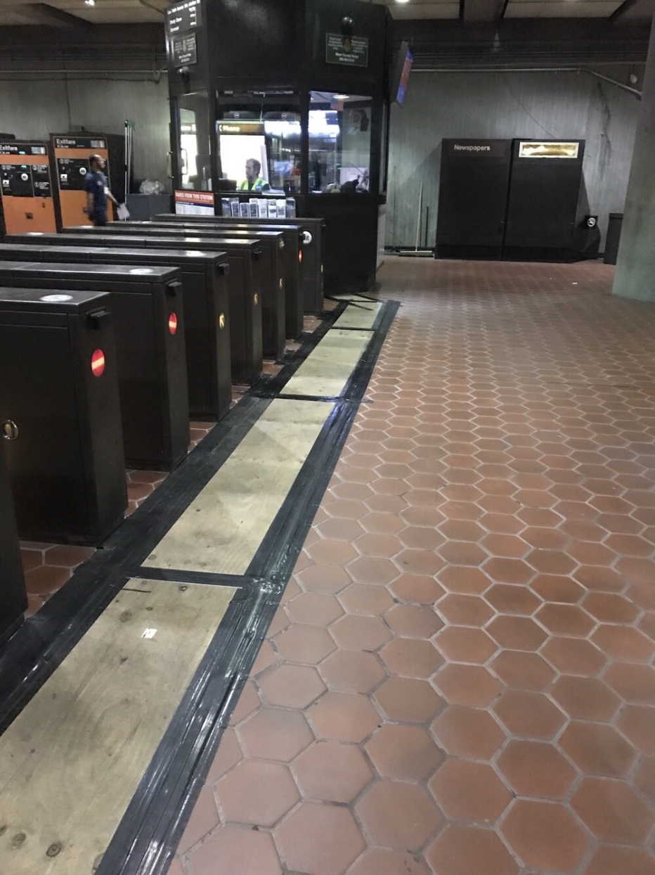
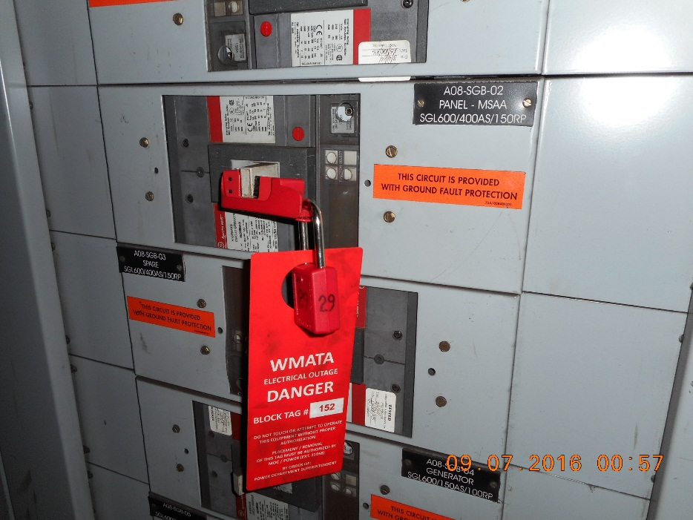
Safety Requirements

Slide 37
Project Management Requirements
Use of Oracle’s Primavera project management software for submittal of cost-loaded project schedules
Use of internet-based Procore project management software for deliverable submittals and review work flow management
Contractor shall provide a full-time, dedicated Project Manager to oversee the project
Contractor shall identify project Quality Manager

Slide 38
Invoice Package Submittals
Certified Pay Application
Monthly Progress Report
Certified Payroll
Updated Cost-Loaded Schedule
DBE/Prompt Payment Report
  Prime Contractor
  Subcontractors
Safety Reports
  C-21
  C-26

Slide 39
Project Meetings
Pre-Construction meetings
  Conducted shortly after NTP to review contract requirements, project coordination, deliverable submission procedures, review safety and security requirements, and coordinate start of construction activities
Project Kick-Off meeting
  Required as needed to discuss special coordination or technical nature of certain construction activities
Weekly Project Coordination meetings
  Discuss work plan/schedule, review safety, and to address administrative/technical issues of concern
Monthly Progress and Quality Management meetings
  Review and determine status of each activity in the Draft Monthly Progress Report, deficiencies, and informal agreement of the Contractor’s monthly progress payment request
Change meetings
  As needed to discuss and resolve change order issues as they arise during the course of construction

Slide 40
Key Dates
Scheduled Event Date
IFB Release February 7
Pre-Bid Conference February 14
Site Visit February 14
Deadline for Proposer Questions February 22
Bid Opening March 15
Deadline to Submit Pre-Award Information March 20
Estimated Award Date April 5
Estimated Notice to Proceed (NTP) April 18
Dates Subject to Change

Slide 41
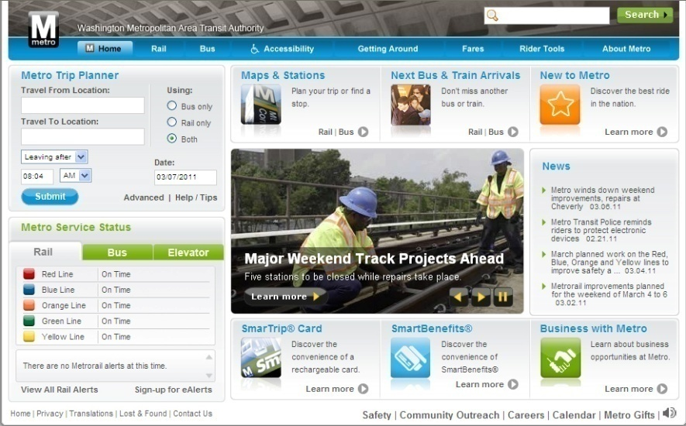
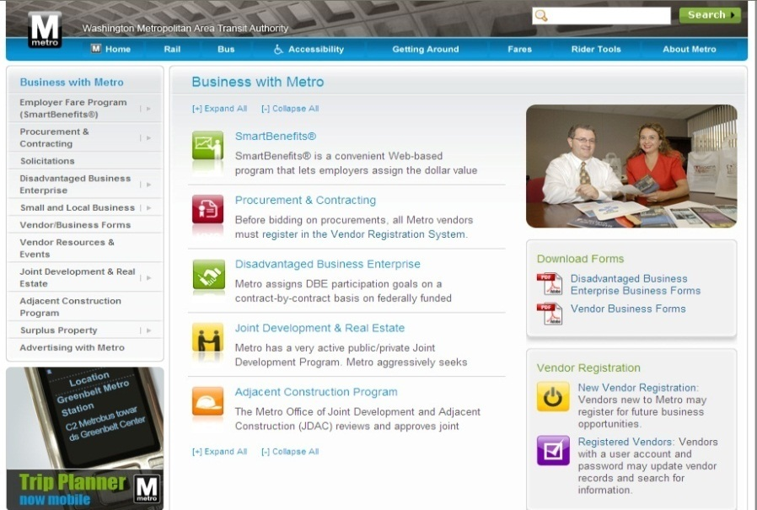
WMATA Website
All Contractors must register with WMATA at www.wmata.com “New Vendor Registration”
WMATA solicitations are publicized at www.wmata.com

Slide 42

Questions

Slide 43
IFB Technical Review Agenda
SOW Elements/Construction Tasks
Work Locations
Construction Task Details
Submittals
Site Access & Power Outage
Site Visit Information

Slide 44
SOW Elements/Construction Tasks
Task Listing
Task 1 – Installation of Under-Floor Duct (electrical) to Electrical Room
Task 2 – Installation of Exposed Conduit
Task 3 – Installation of Faregate Array Under-Floor Duct (Data)
Task 4 – Installation of Faregate Array Under-Floor Duct (Electrical)
Task 5 – New CAT6 Cable Installation, Termination (Both Ends), and Testing
Task 6 – Existing CAT6 Cable Termination (Both Ends) and Testing
Task 7 – Installation and Termination of Electrical Circuit Cables
Task 8 – Installation, Termination, and Testing of Fiber Optic Cables from Kiosk to Mini-Mezzanine and CAT6 cables between Mini-Mezzanine Devices
Task 9 – Re-pulling, Termination, and Testing, of existing, but defective CAT6 cables between kiosk and fare vending devices or faregates that fail testing

Slide 45
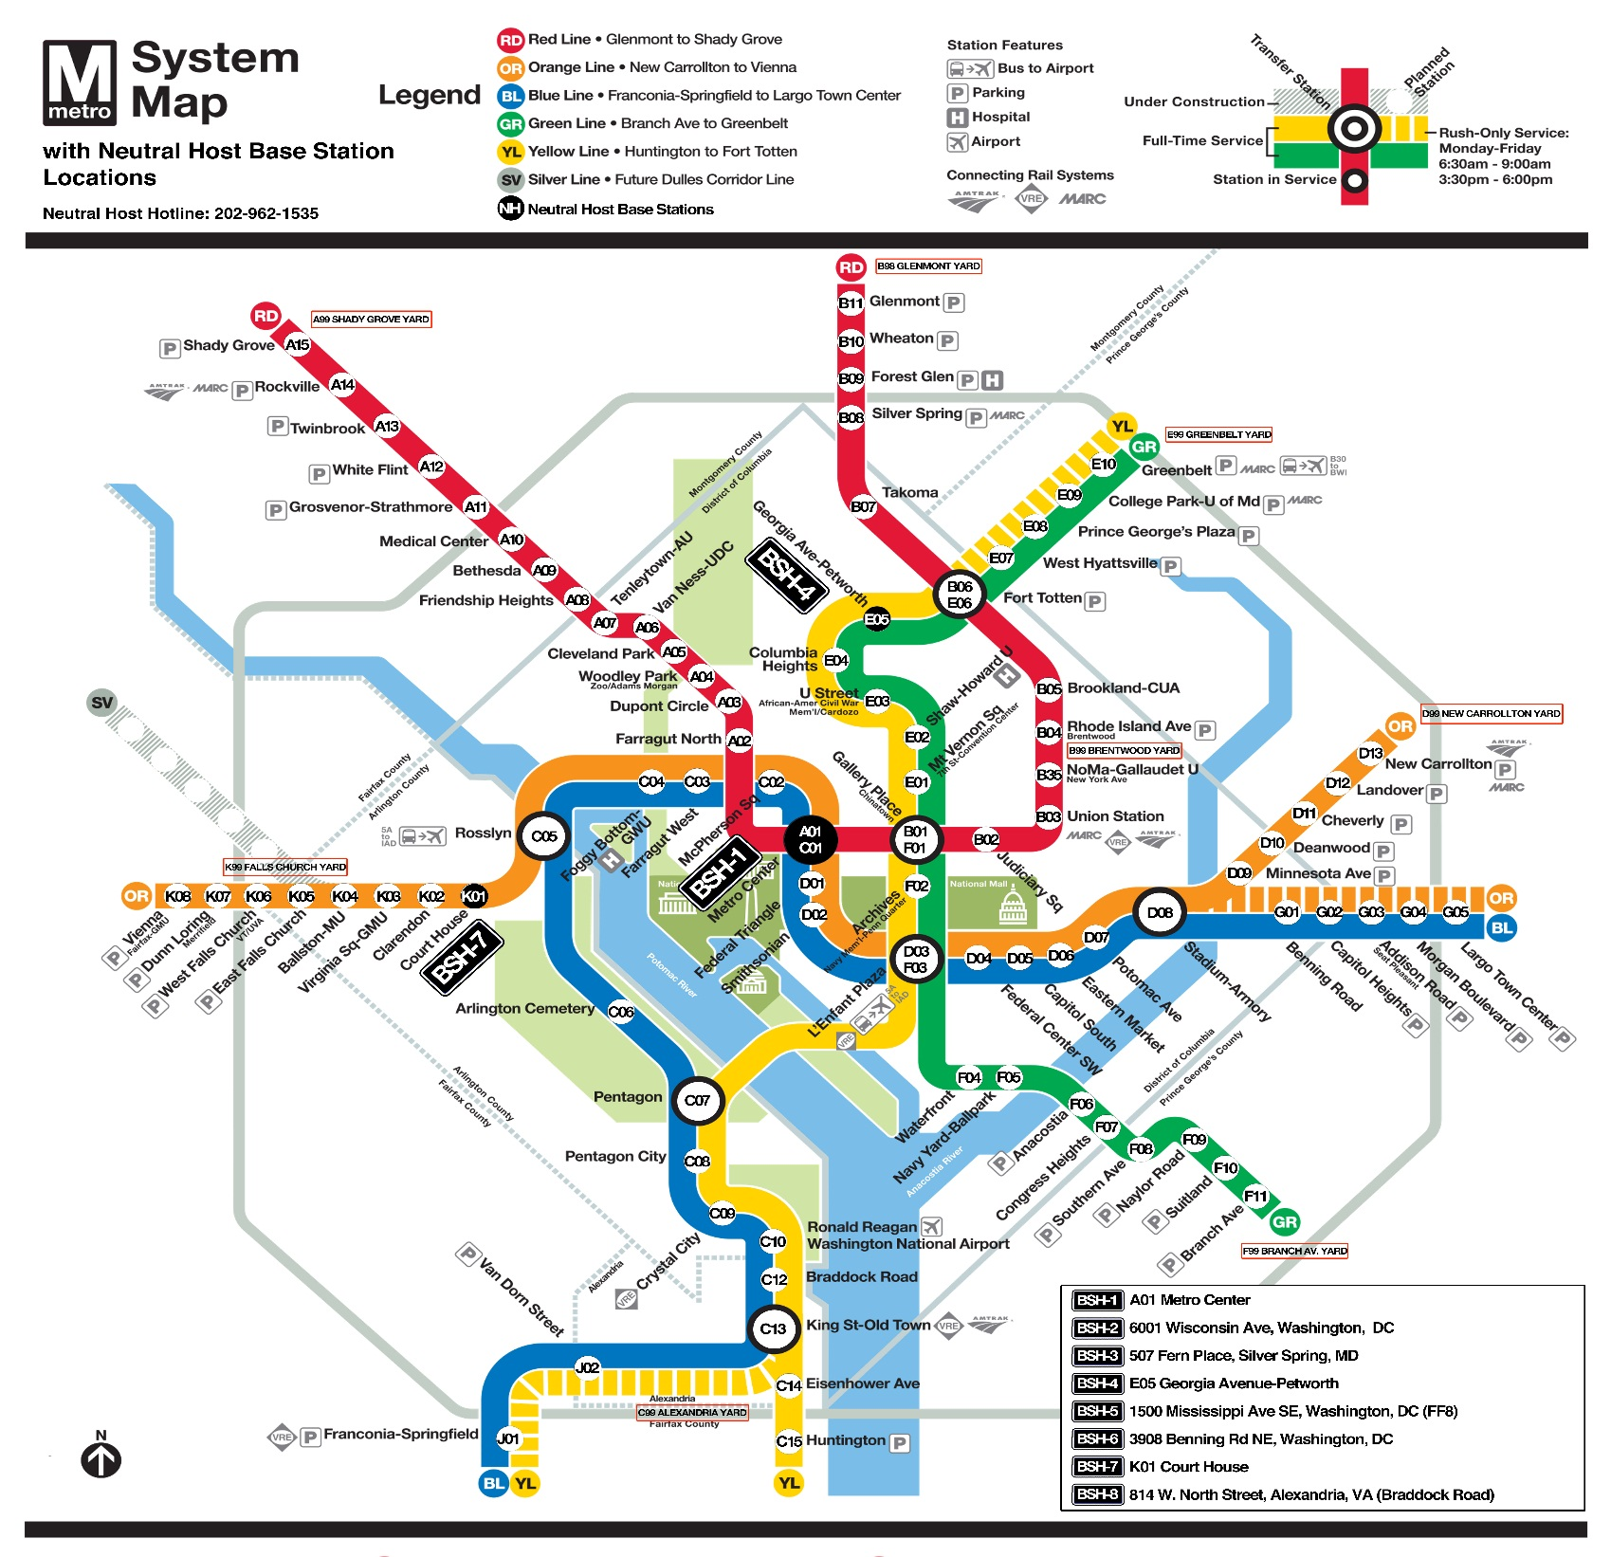
Work Locations
Work Locations are system-wide at 83 Metrorail station Mezzanines and Mini-Mezzanines on the Red, Orange/Blue, and Green/Yellow lines in Virginia, Maryland, and Washington, DC.

Slide 46
Sample Construction Tasks by Location
Orange/Blue Lines
 | STATION NAME (MEZZANINE) | STATION ID | MEZZ ID | 1 | 2 | 3 | 4 | 5 | 6 | 7 | 8 | 9
1 | METRO CENTER (NORTH MEZZANINE) | C01 | 035 |  |  |  |  | X |  |  |  | A S N E E D E D
2 | METRO CENTER (SOUTH MEZZANINE) | C01 | 052 |  |  |  |  | X
3 | MCPHERSON SQUARE (EAST MEZZANINE) | C02 | 036 |  |  |  |  | X | X | X
4 | MCPHERSON SQUARE (WEST MEZZANINE) | C02 | 037 |  |  |  |  | X | X | X
5 | FARRAGUT WEST (EAST MEZZANINE) | C03 | 038 | X |  |  |  | X | X | X
6 | FOGGY BOTTOM-GWU | C04 | 040 |  | X |  |  | X | X | X
7 | ROSSLYN | C05 | 041 |  |  |  |  | X | X | X
8 | ROSSLYN (SIDE/NEW ENTRANCE) | C05 | 113 |  |  |  |  | X | X | X
9 | ARLINGTON CEMETERY | C06 | 042 |  |  |  |  | X | X | X
10 | ARLINGTON CEMETERY (PLATFORM) | C06 | 042M |  |  |  |  | X |  |  | X
11 | FEDERAL TRIANGLE | D01 | 053 |  | X | X |  | X | X | X
12 | SMITHSONIAN (NORTH MEZZANINE) | D02 | 054 |  |  |  |  | X | X | X
13 | SMITHSONIAN (SOUTH MEZZANINE) | D02 | 055 |  |  |  |  | X | X | X
14 | SMITHSONIAN (EASTBOUND PLATFORM) | D02 | 055M |  |  |  |  | X |  |  | X
15 | L'ENFANT PLAZA (WEST MEZZANINE) | D03 | 056 |  | X |  |  | X | X | X
16 | L'ENFANT PLAZA (EAST MEZZANINE) | D03 | 057 |  |  |  |  | X | X | X
17 | FEDERAL CENTER SW | D04 | 058 | X | X | X |  | X | X | X
18 | CAPITOL SOUTH | D05 | 059 |  | X |  |  | X | X | X
19 | EASTERN MARKET | D06 | 060 |  |  |  |  | X | X | X
20 | POTOMAC AVENUE | D07 | 061 |  | X |  |  | X | X | X
21 | STADIUM-ARMORY (SOUTH MEZZANINE) | D08 | 062 |  |  |  |  | X | X | X

Slide 47
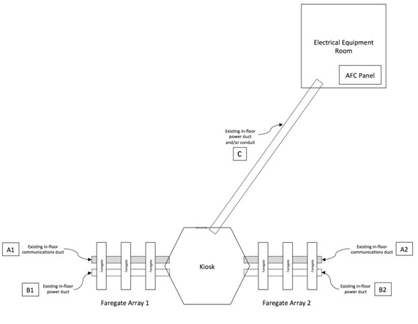
Construction Tasks Details
Typical Mezzanine Layout

Slide 48
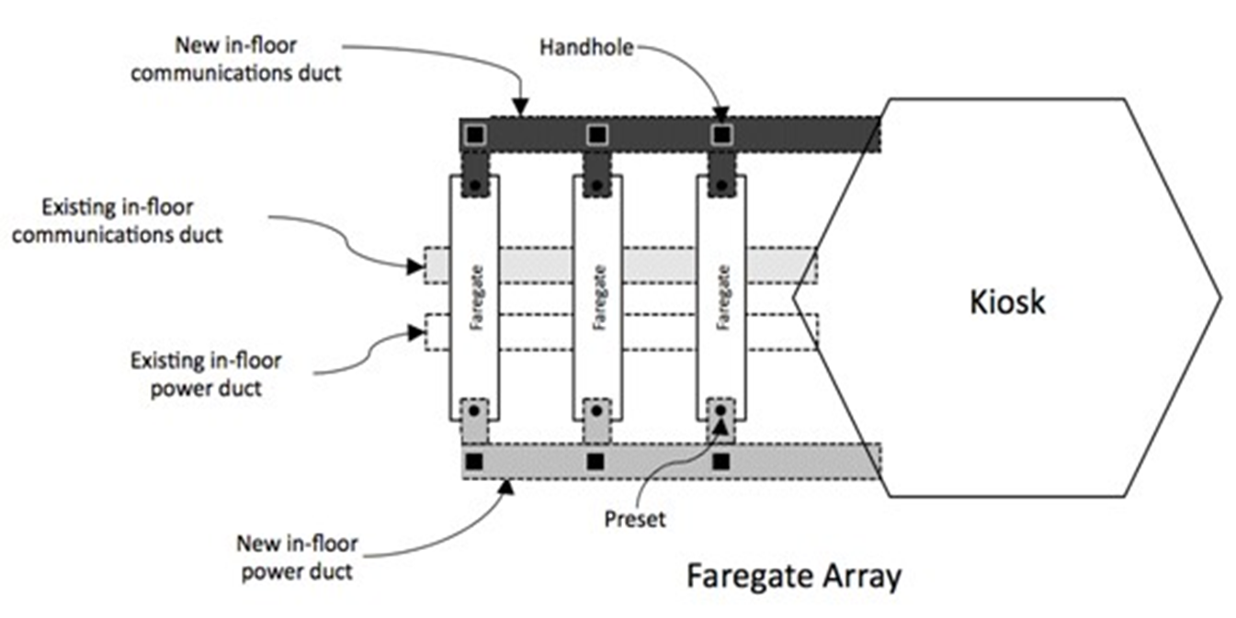
Construction Tasks Details
Under-floor Duct Installation

Slide 49
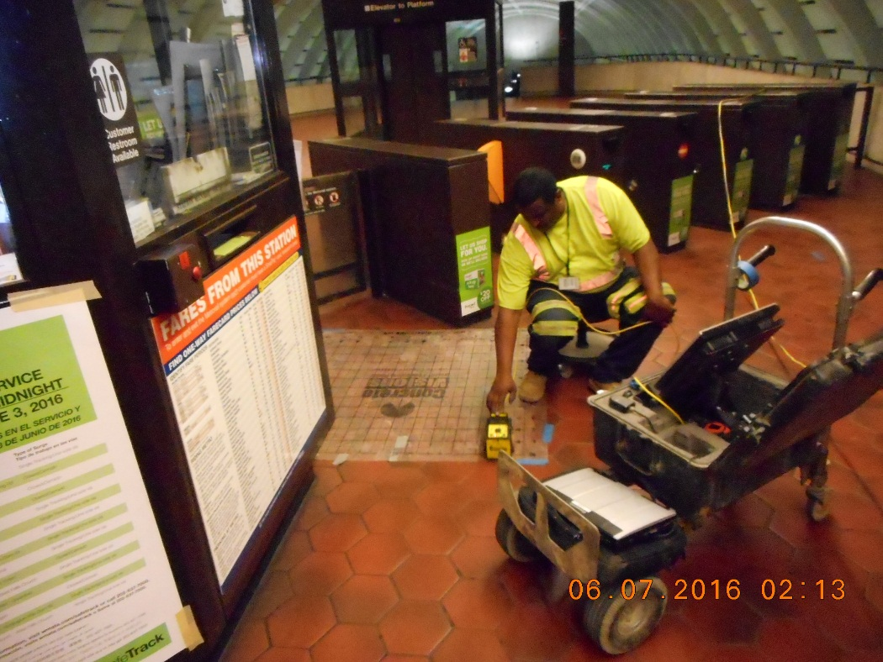
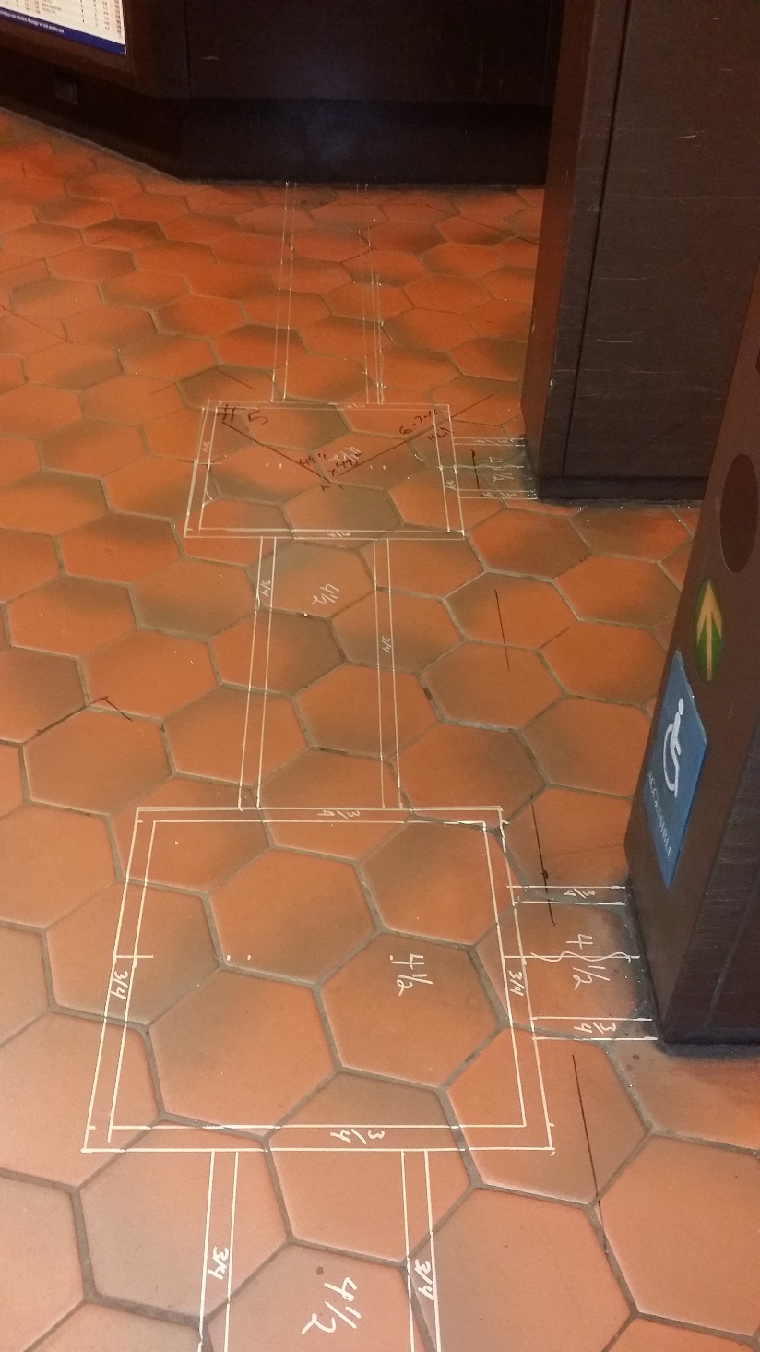
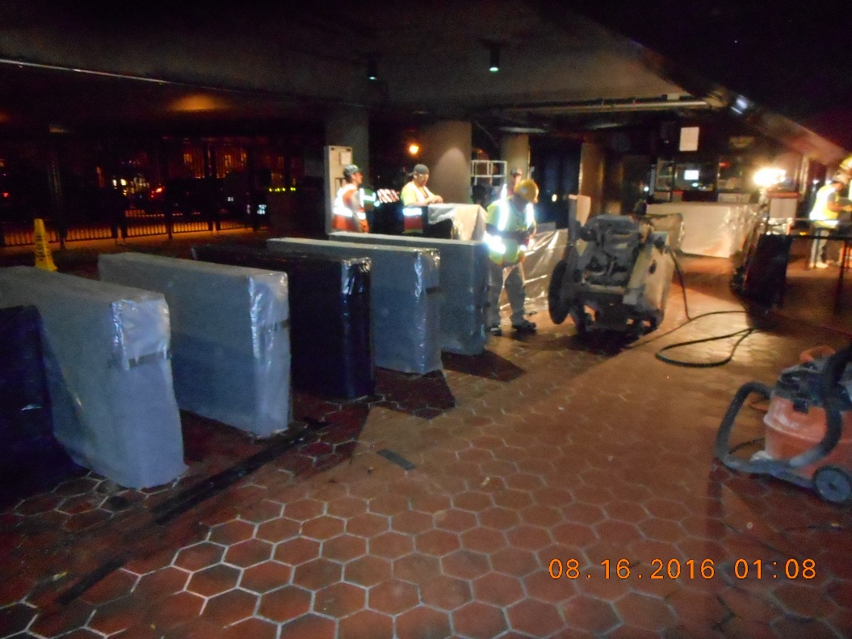
Construction Tasks Details
Under-floor Duct Installation
Protecting equipment from dust
Saw cutting and trenching
Sealant of U/F ducts
49

Slide 50
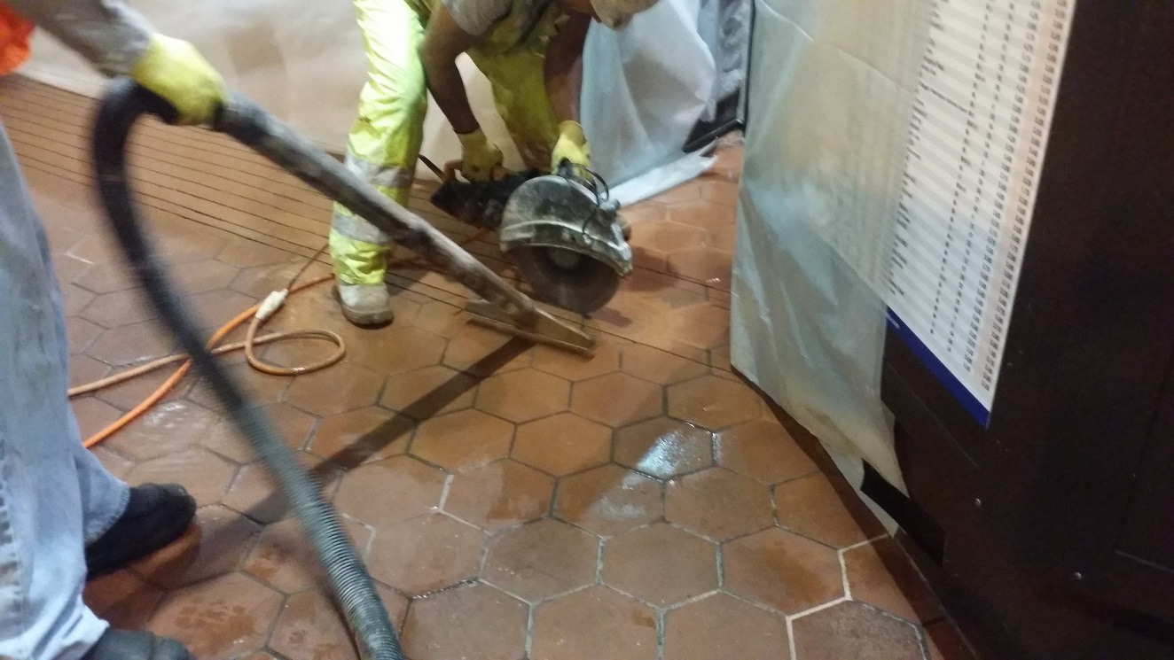
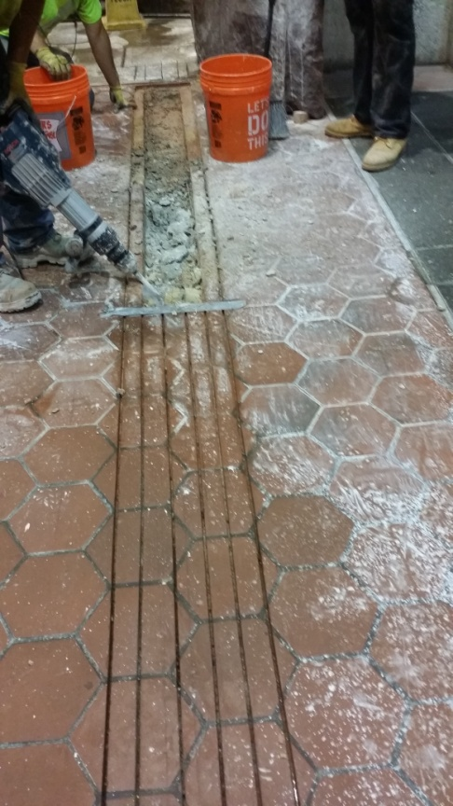
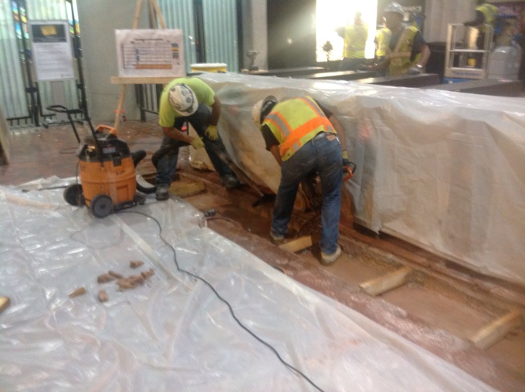
Construction Tasks Details
Under-floor Duct Installation
Protecting equipment from dust
Saw cutting and trenching
Sealant of U/F ducts
50

Slide 51
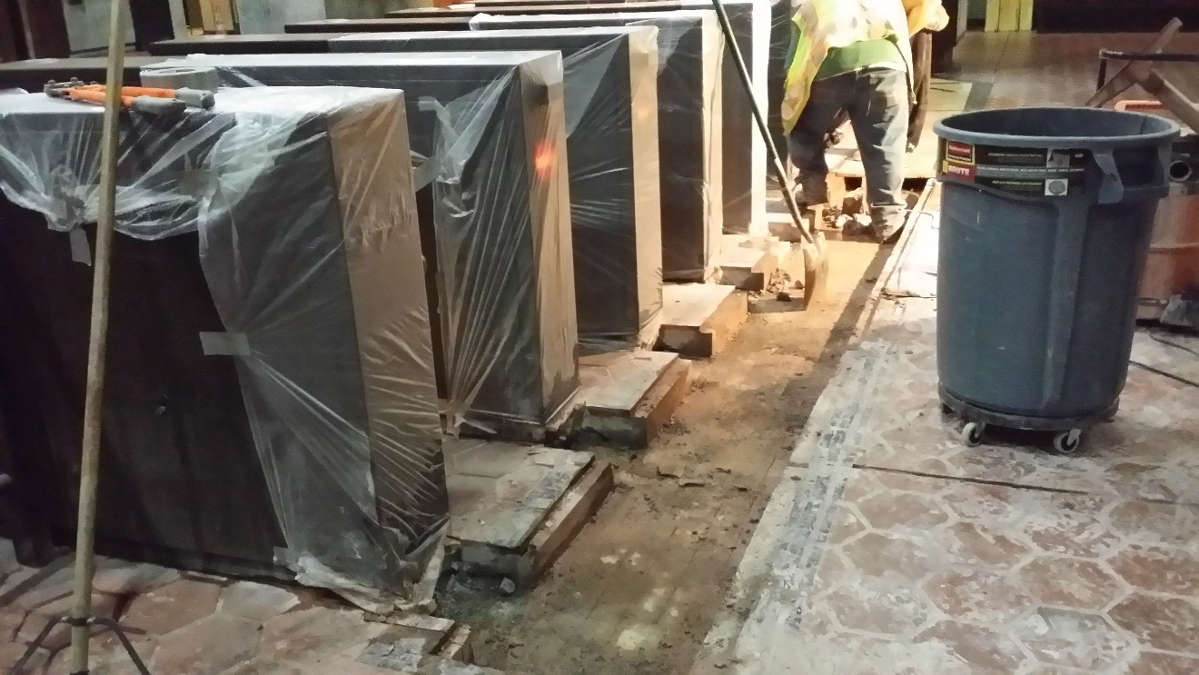
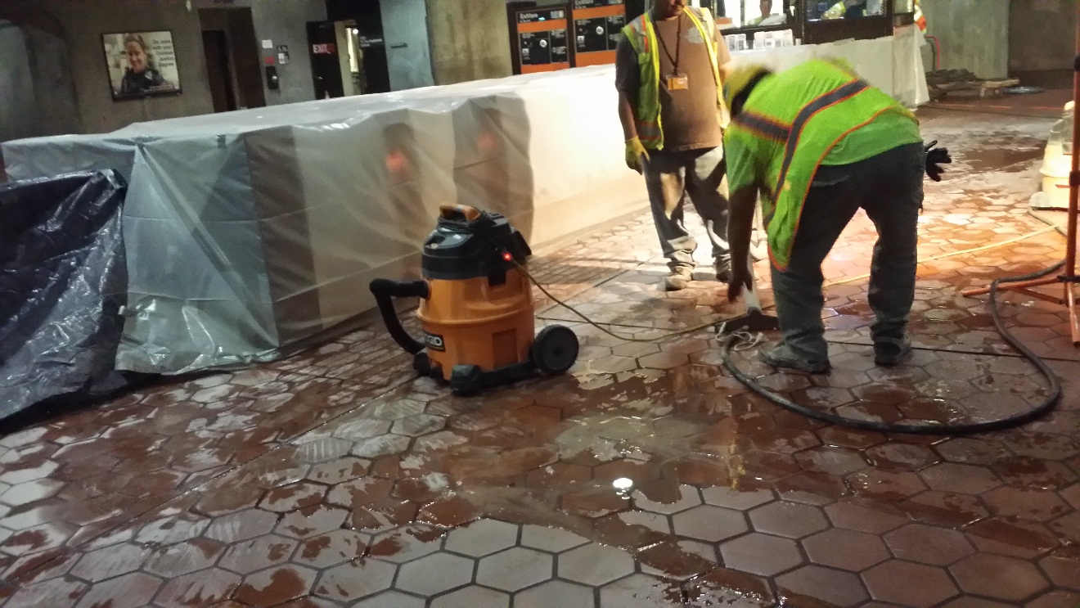
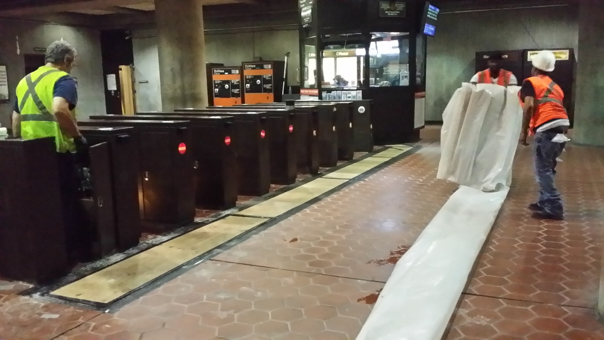
Construction Tasks Details
Under-floor Duct Installation
Protecting equipment from dust
Saw cutting and trenching
Sealant of U/F ducts
51

Slide 52
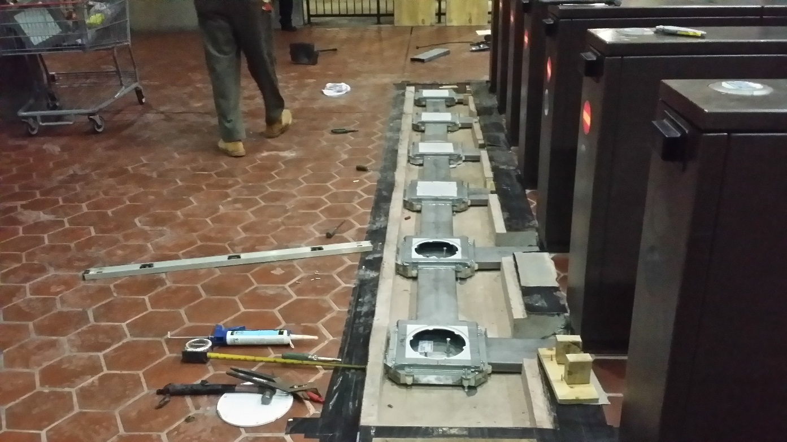
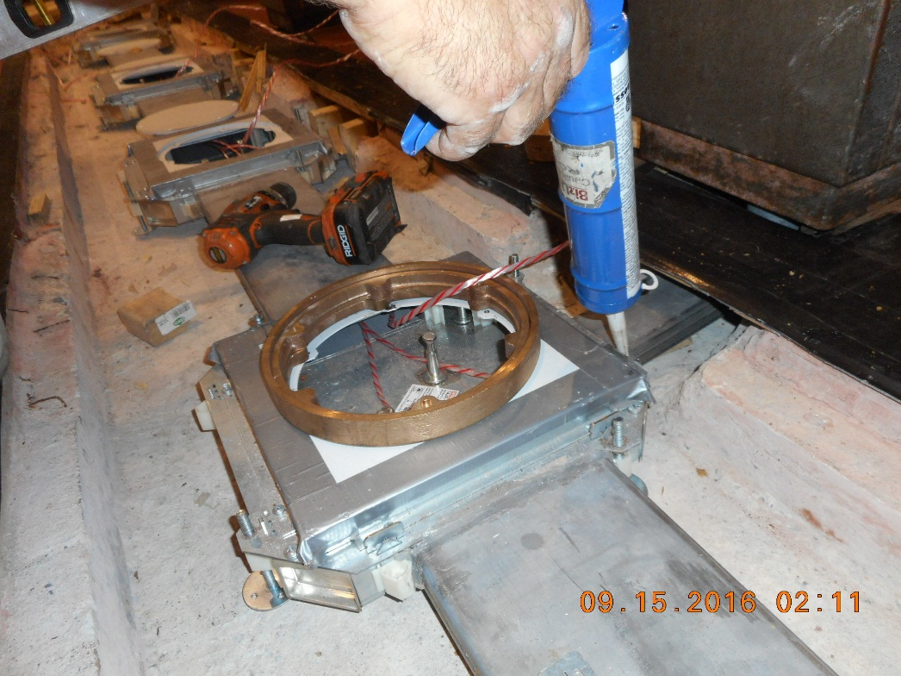
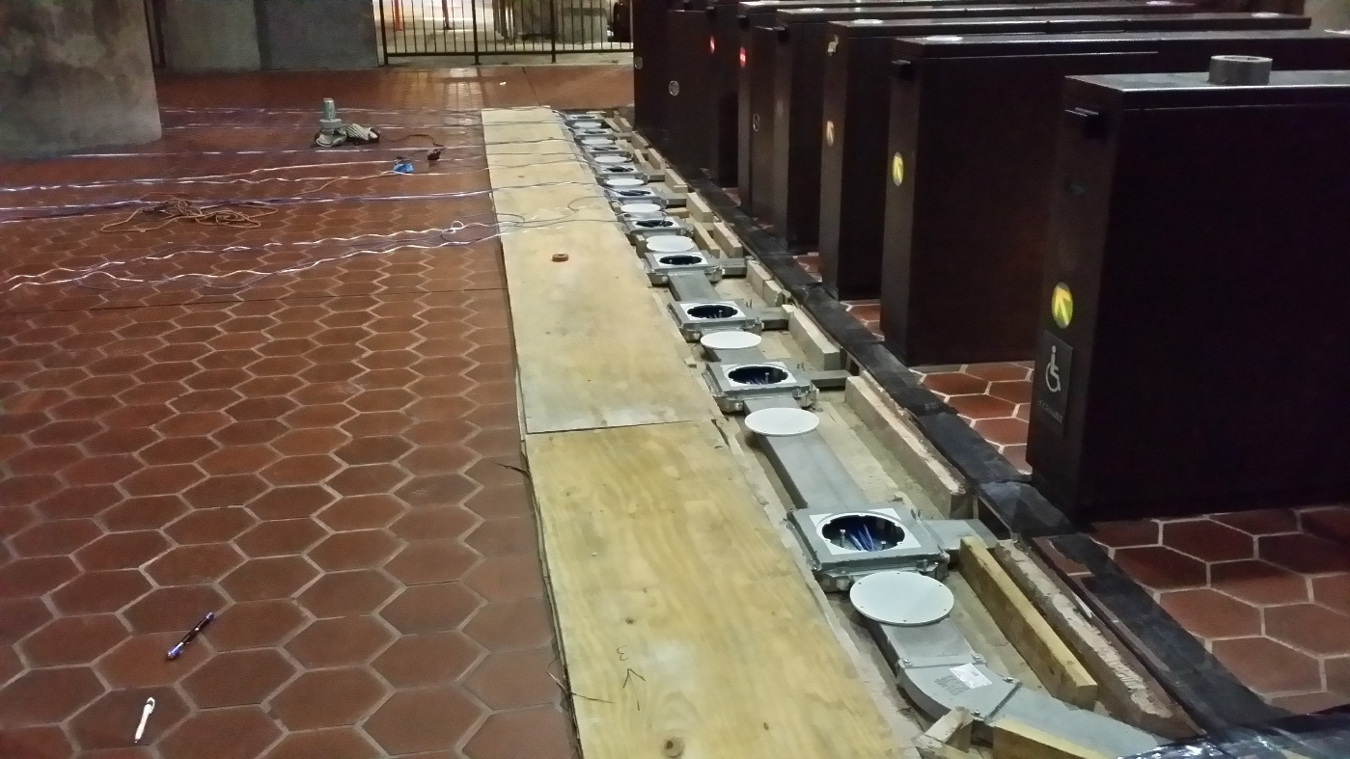
Construction Tasks Details
Under-floor Duct Installation
Protecting equipment from dust
Saw cutting and trenching
Sealant of U/F ducts
52

Slide 53
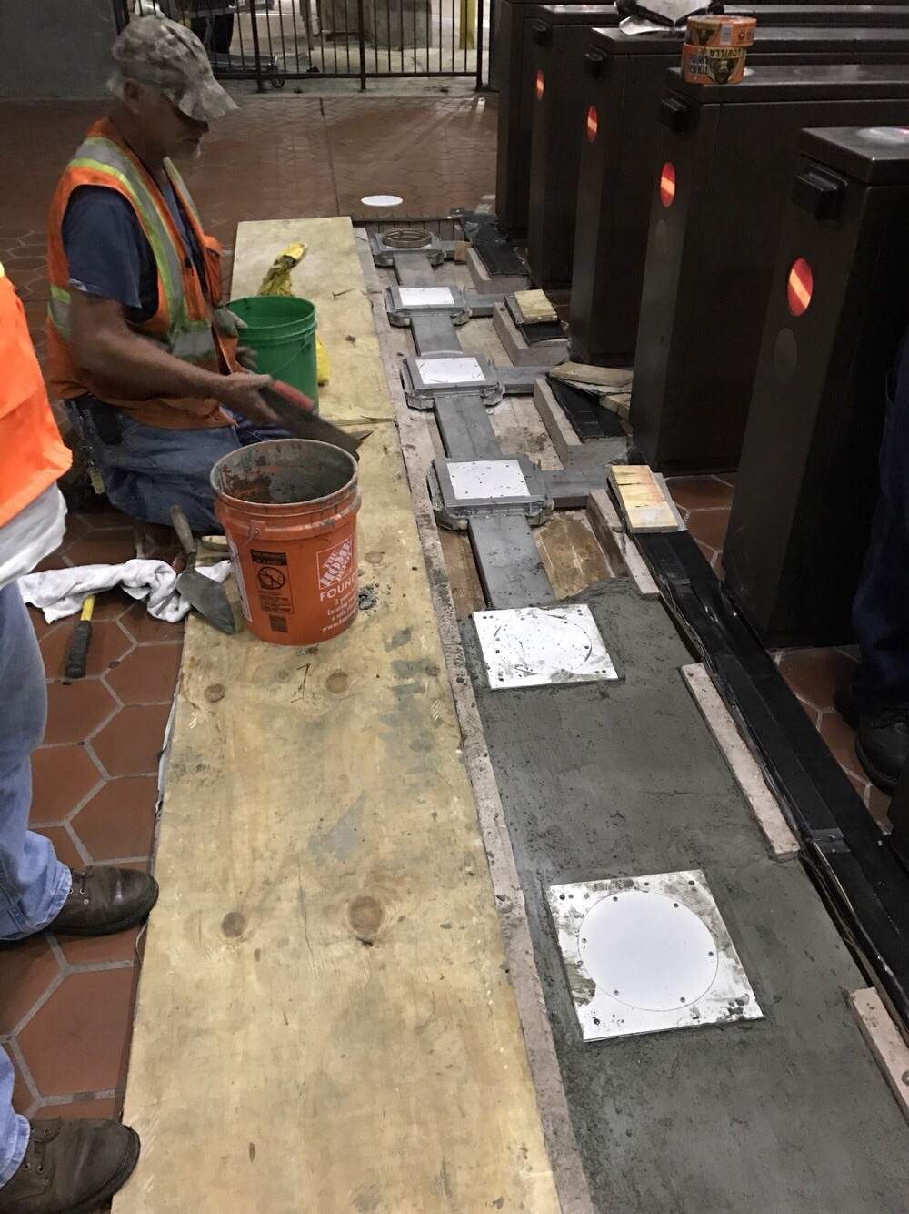
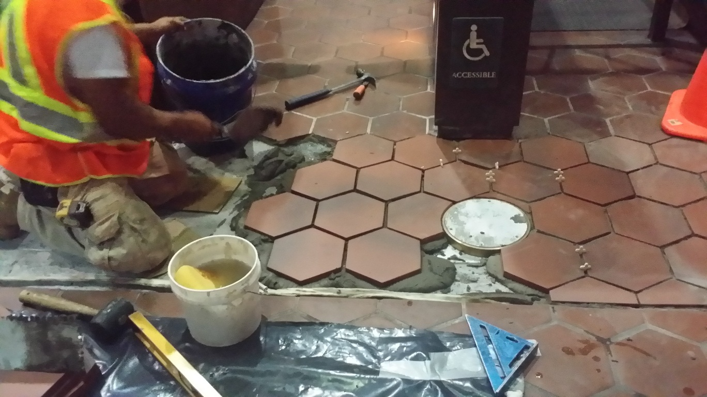
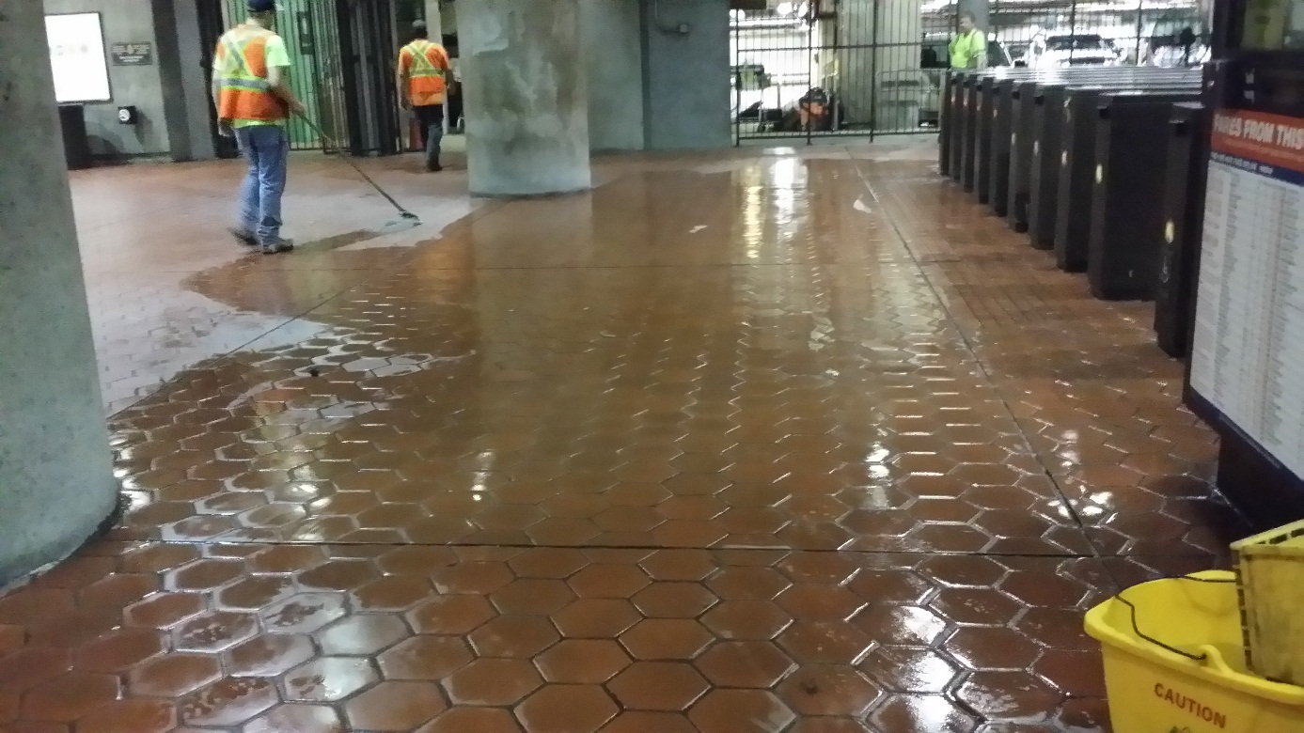
Construction Tasks Details
Under-floor Duct Installation
Protecting equipment from dust
Saw cutting and trenching
Sealant of U/F ducts

Slide 54
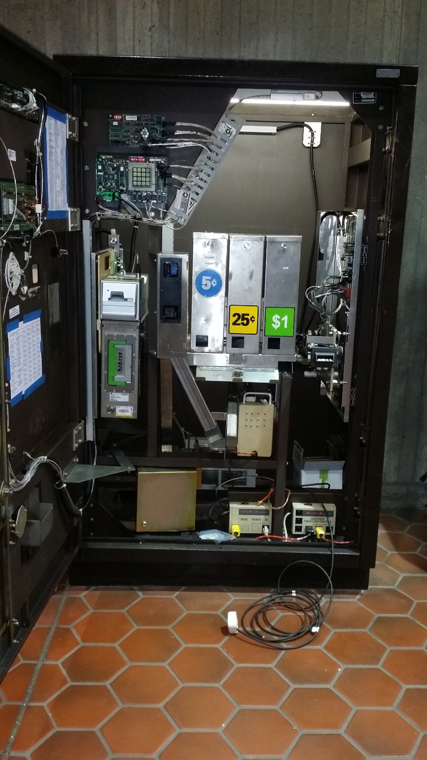
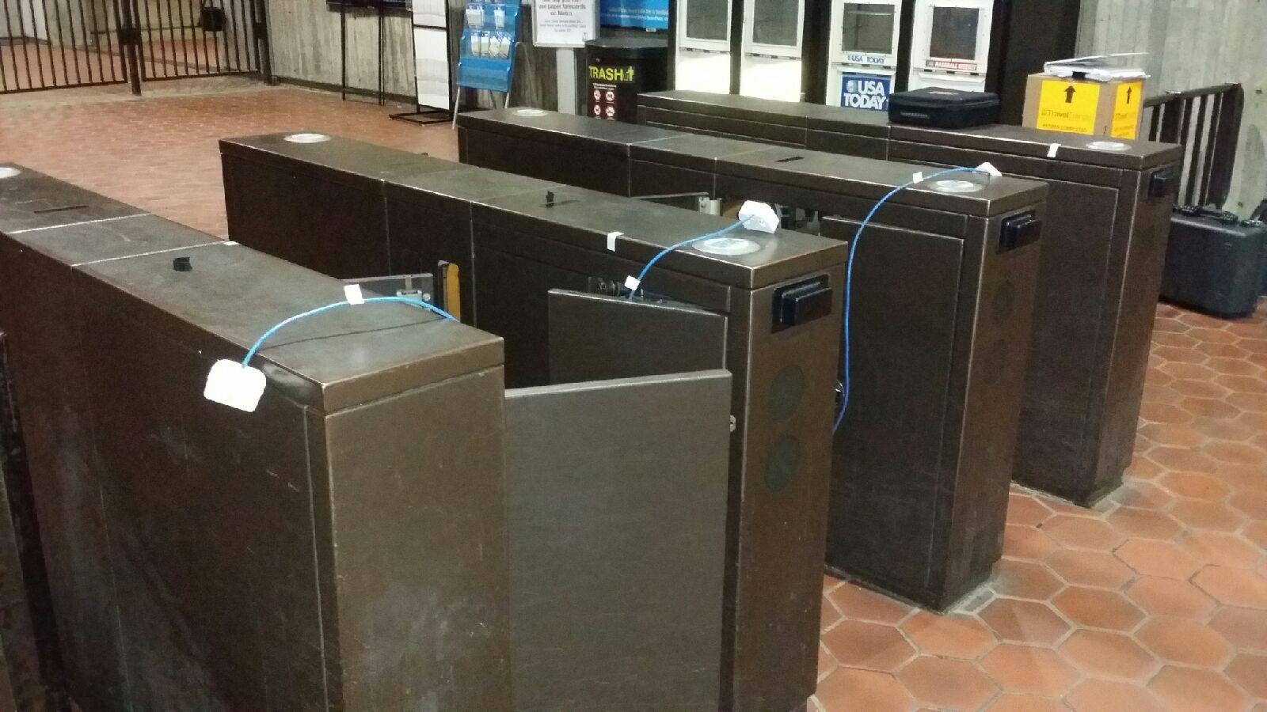
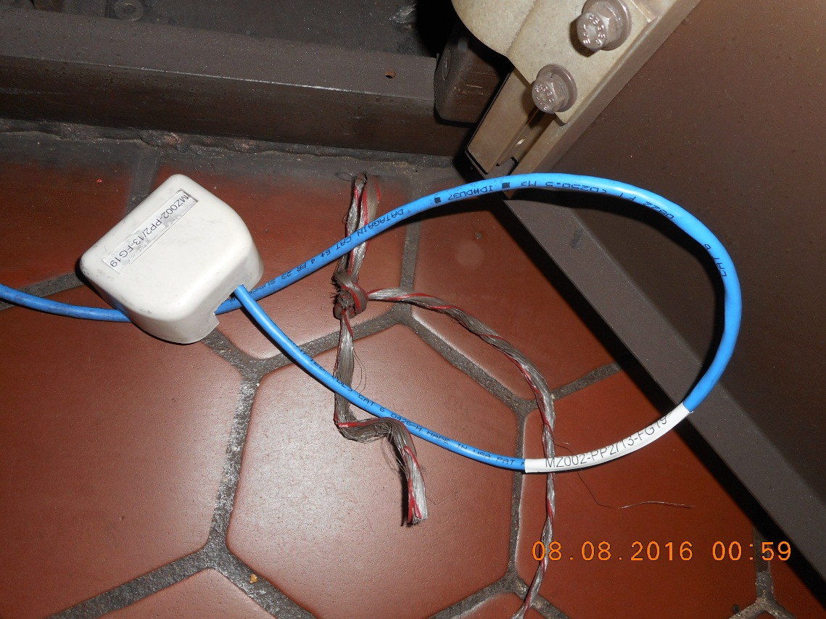
Construction Tasks Details
Data Cable Installation

Slide 55
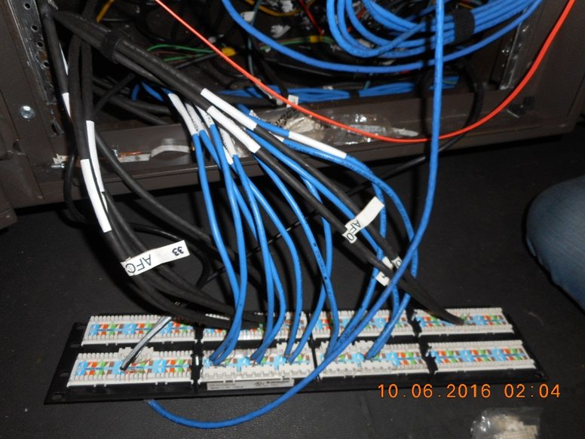
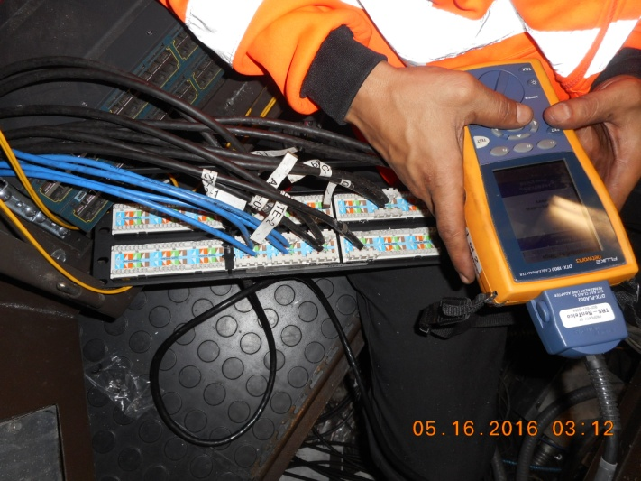
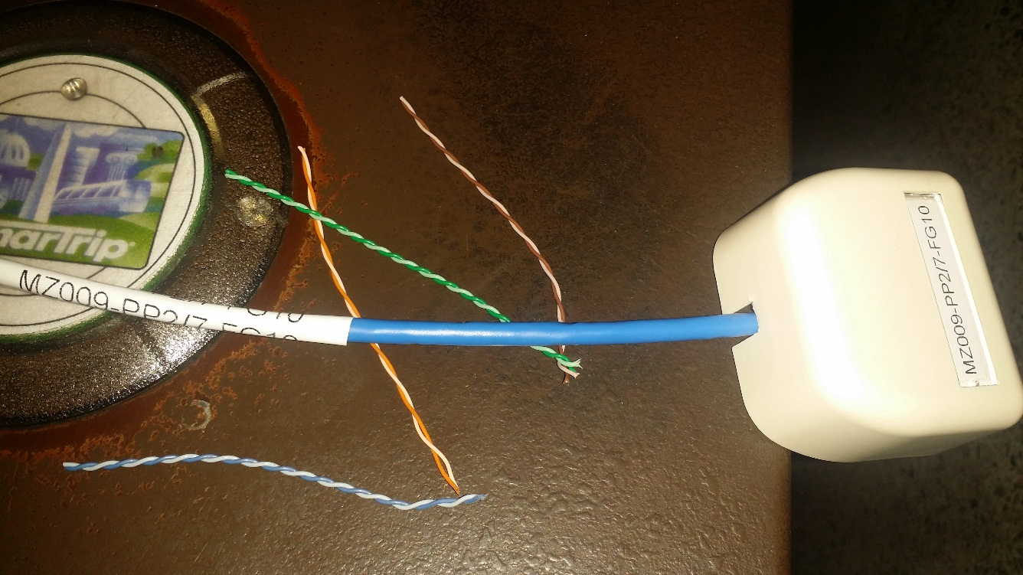
Construction Tasks Details
Data Cable Installation

Slide 56
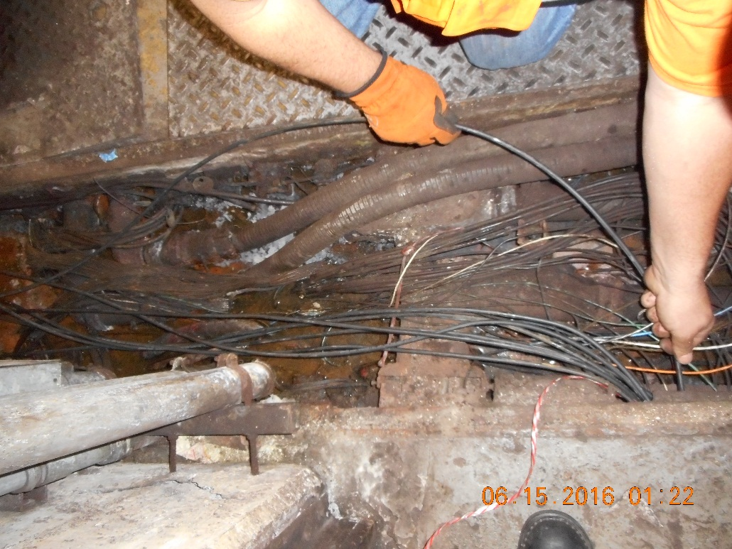
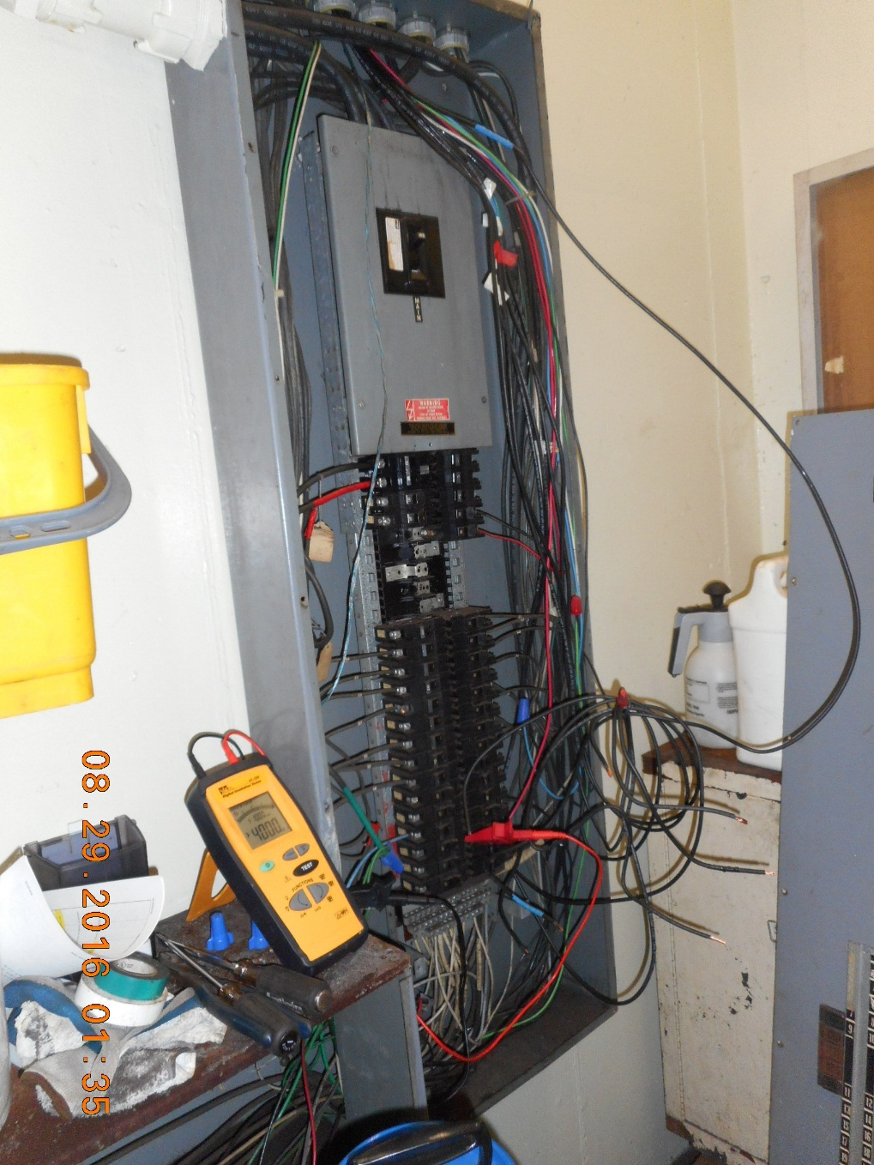
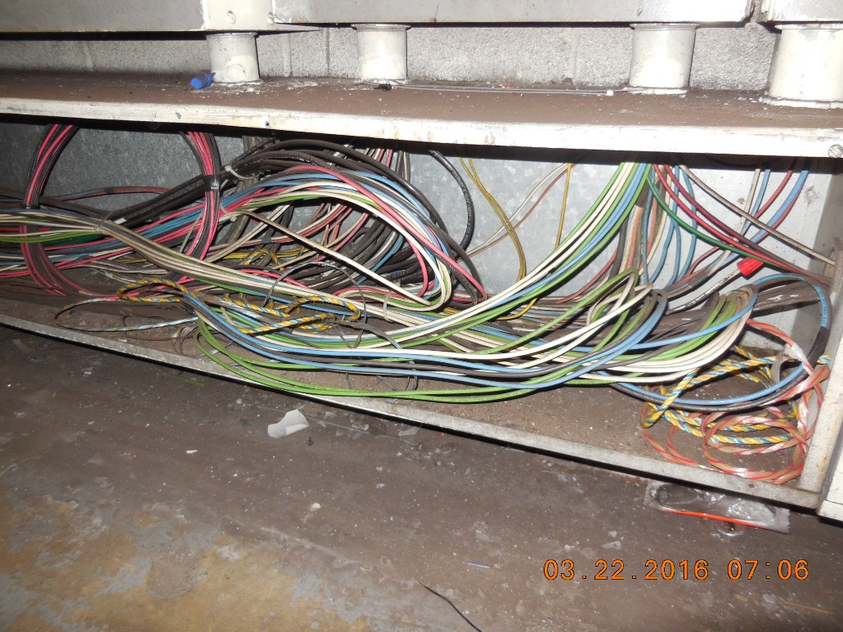
Construction Tasks Details
Electrical Installation

Slide 57
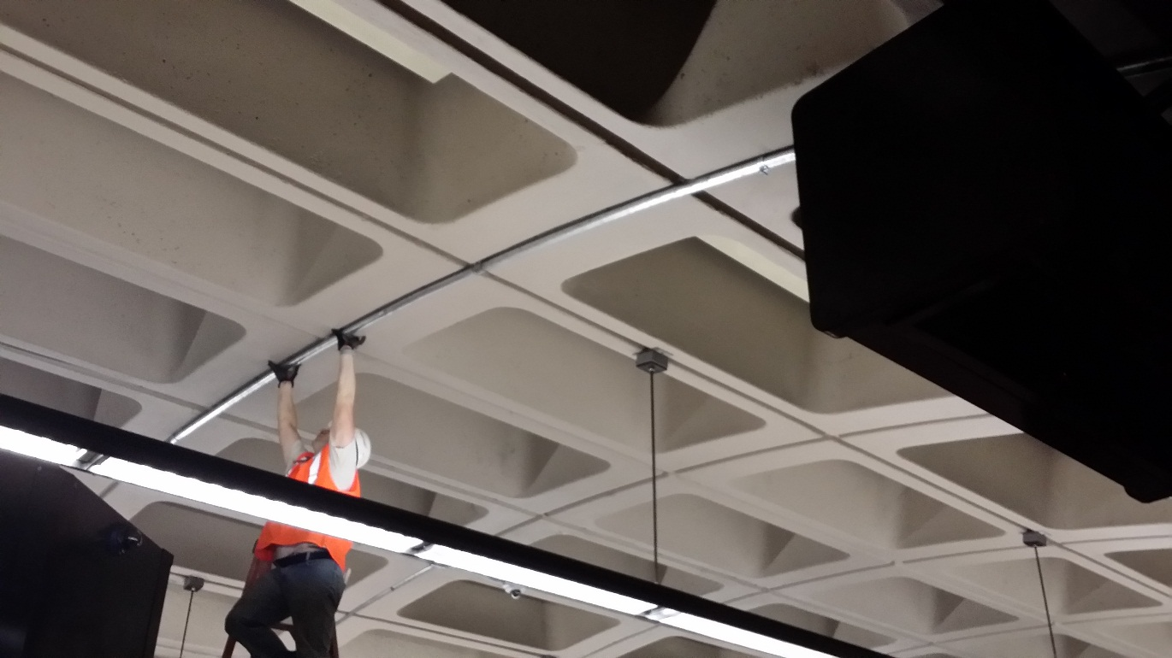
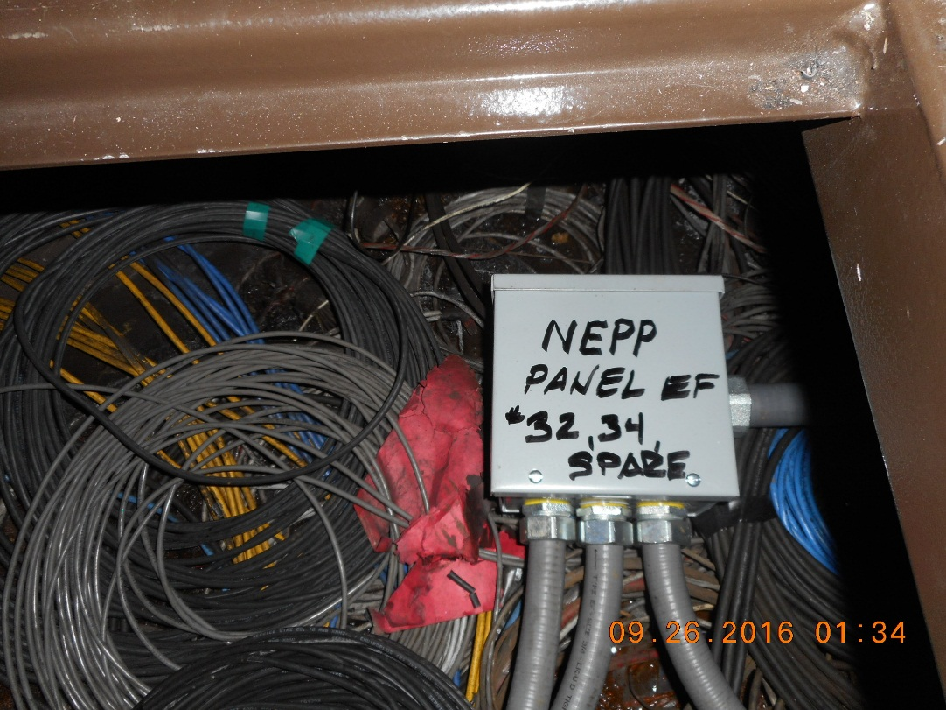
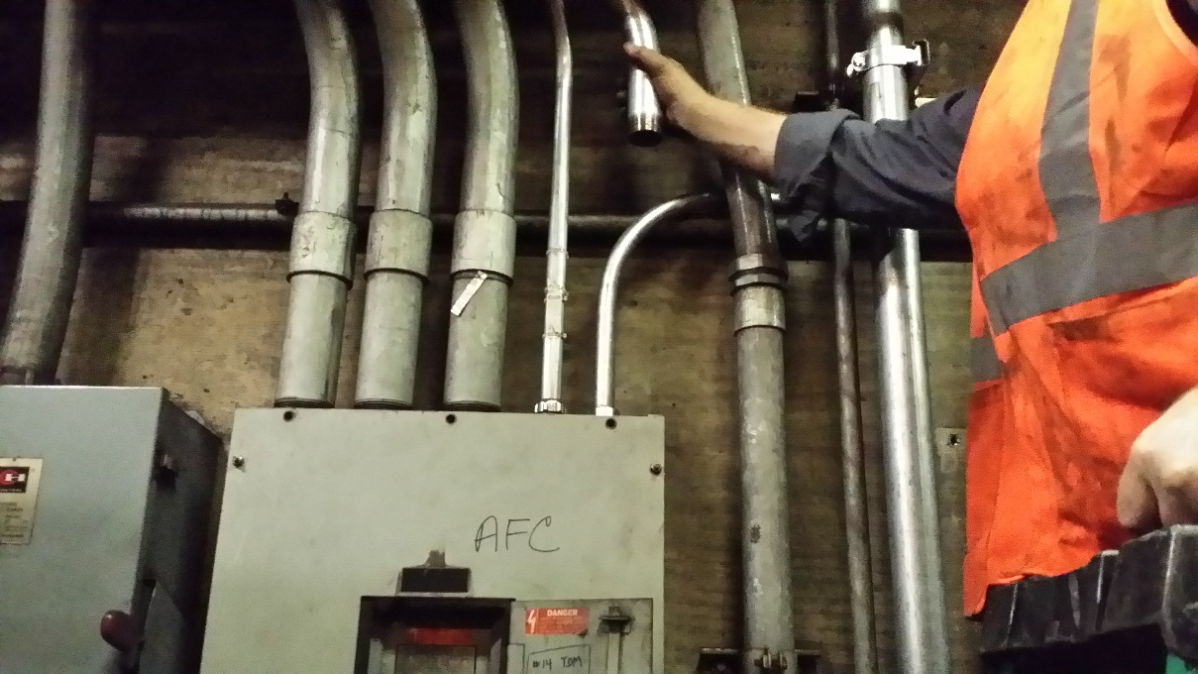
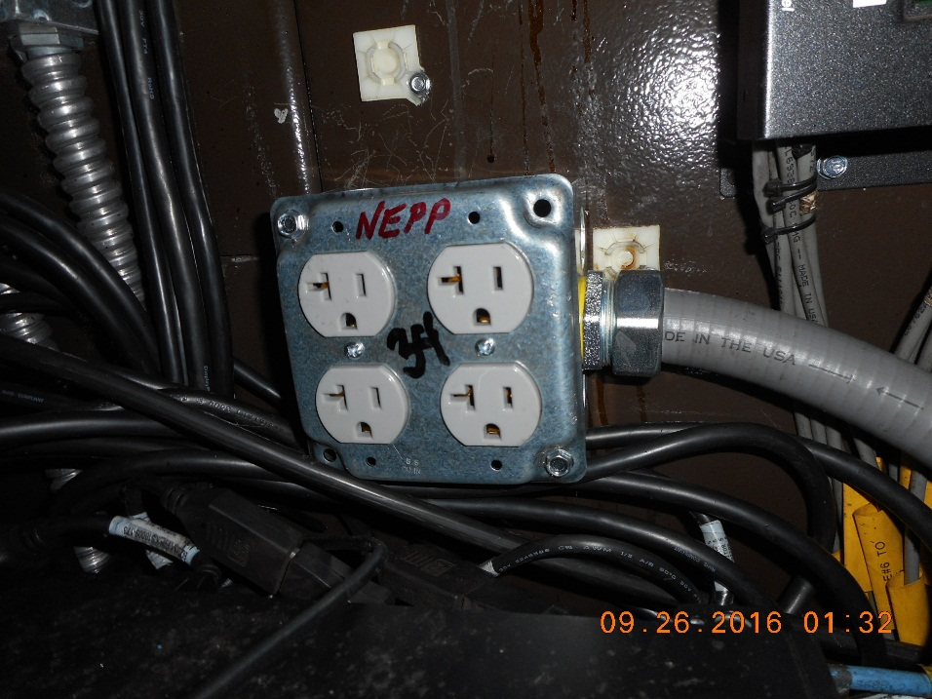
Construction Tasks Details
Electrical Installation

Slide 58
Construction Tasks Details
Mezzanine-Specific Work Details
Division 1
  Section 01117: Construction Tasks Details
      Part 1.3: Mezzanine-Specific Work Details
          17. D04 Federal Center SW 058
Upper faregate array communications cabling duct is collapsed requiring installation of UF communications duct for this array (Task 3). Power duct between Kiosk and HH1 has collapsed. This condition requires repair of one of four alternate runs of electrical cabling UF walker duct, installation of a junction box (Task 1), and the installation of new exposed conduit (Task 2) so that a clear path between the Kiosk and AFC Panel can be established. Refer to MIR for full path of proposed power cabling and duct runs. Location also requires installation and termination of new CAT6 cables which run from faregates to Kiosk, termination of existing CAT6 cabling from Vending Machines to the Kiosk, and installation and termination of electrical circuit cables which run from the AFC Electrical Panel to the Kiosk (Task items 5 through 7). Refer to Section the relevant MIR for additional information.

Slide 59
Construction Tasks Details
Mezzanine Inspection Reports - MIR

Slide 60
Construction Tasks Details
Mini-Mezzanine Layout (1)

Slide 61
Construction Tasks Details
Mini-Mezzanine Layout (2)

Slide 62
Pre-Construction Submittals
Site-Specific Work Plan (SSWP)
Project-Specific Quality Management Plan (PSQMP)
Supplemental Installation Work Plan for all locations with conduit and/or duct installation
Detailed Primavera Cost-Loaded Project Schedule
Product & Material data/catalog sheets
Badge and RWP training requests

Slide 63
Site-Specific Work Plan (SSWP)
Summary Statement section
Description of Work
  Detailed Scope of Work; Pre-Installation Requirements; Period of Performance; Days & Hours of Work; Mobilization and Staging; Materials; Deliverables; Repairs on event of damage
Work Location and Power Outage
  Detailed power outage and LOTO procedure, detailed work location description
Project Dates/Support/Equipment Section
Safety Plan
  General Regulatory and Safety Requirements; Job Hazard Analysis; Confined Space; Fall Protection; Installation inside the battery & ELES rooms; Core drilling, saw cutting and trenching; Electrical Protection; Hazardous Materials; Public and Passenger Protection; Fire Safety; Clothing and Personal Protective Equipment
Work Activity Schedule
  Critical milestones; contingency plan
Worksite Contacts Section
Supporting Documents
  Drawings; Project Schedule; Company Safety Plan; Supplemental raceways installation work plan

Slide 64
Supplemental Installation Work Plans
Contractor-submitted Supplemental Installation Work Plans for all locations requiring conduit and/or duct must include:
  Work description
  Schematics of raceway pathways, core drills, and other transitions
  Confirmation of adherence to WMATA requirements for saw cutting, drilling, trenching, duct/conduit installation, and floor restoration
  Scanning reports
  List of tools and materials to be used
  Verification of Personal Protection Equipment (PPE)
  Trench covering and WMATA equipment protection approach
  Site clean-up approach

Slide 65
Construction Submittals
Progress Report
Four-Week Look-Ahead Schedule (updated weekly)
Switching Order Request (for target week)
Escort Request (one week in advance)
Daily Work Plans and Updates
Weekly meeting minutes
Requests for Information (RFIs)
Test Reports
  Power Cable Insulation Resistance testing
  CAT6 Cable testing
  Fiber Optic Cable testing
As-Built Mezzanine Schematics

Slide 66
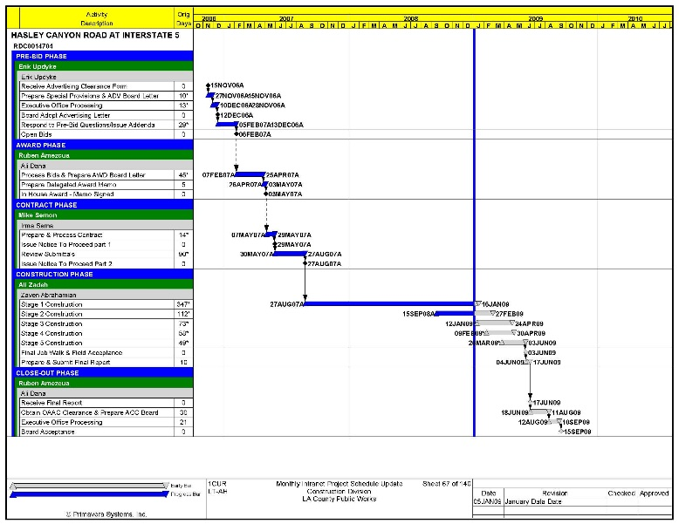
Site Access & Power Outage
Submittal Process
SSWP Request (60 Days)
Escort Request
(7 days / Monday, Prior Target Week)
Target
Week
(Work Start on Sunday Night)
GOTRS / SO Request
(21 Days)
Escort Approved
(Thursday, Prior Target Week)
SO Request Confirmation
(7 days / Monday, Prior Target Week)
SO Approved
(Friday, Prior Target Week)

Slide 67
Site Visit Information
A site visit will be held Today, February 14 immediately after Pre-Bid Conference
Meeting point will be Federal Center Station (D & 3rd streets SW), Station Manager Kiosk
All attendees will be required to have with them OSHA-approved safety vests and sturdy boots/shoes to go to the ancillary area

Slide 68
Questions

